Slide 1
Building jQuery Plugins
Ian Robinson

Slide 2

Ian Robinson
Twitter @irobinson
GitHub http://github.com/irobinson
Professional Profile http://bit.ly/irobinson
jQuery Crash Course
  http://jquery.ian-robinson.com

Slide 3
The Value of
JavaScript Libraries
Web Statelessness
  responsiveness doesn't come natural
JavaScript
  misunderstood and abused raw power
Browsers
  each do things a bit differently

Slide 4
[jQuery]

Slide 5
jQuery
Is a JavaScript abstraction
Is a collection of solved problems(shortcuts, utilities)
Has an sweet plugin model
Is totally ubiquitous
Has a vibrant community
Originally made JavaScript fun again
Now just makes JavaScript completely awesome

Slide 6
So it’s basically a clean foundation from which to build rich user interaction

Slide 7
[Plugins]

Slide 8
And a plugin is…?
Taking the helpfulness a bit further
Often a reusable component
Structured for maintainability and compatibility

Slide 9
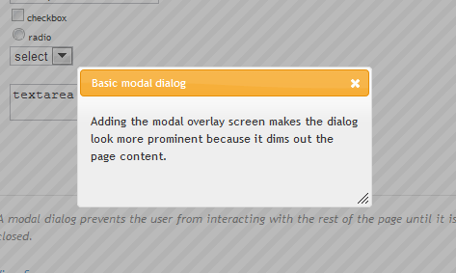
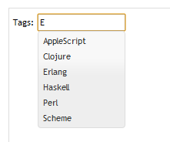
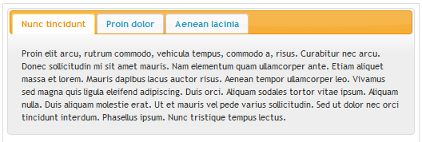
Canonical Example: jQuery UI

Slide 10
Popular in the Community
Interaction
  Cycle – slideshows…
  Hover Intent – sophisticated hovering
  Table Sorter – spiff up tables
Utility
  Back Button & Query Library (BBQ)
  Cookie

Slide 11
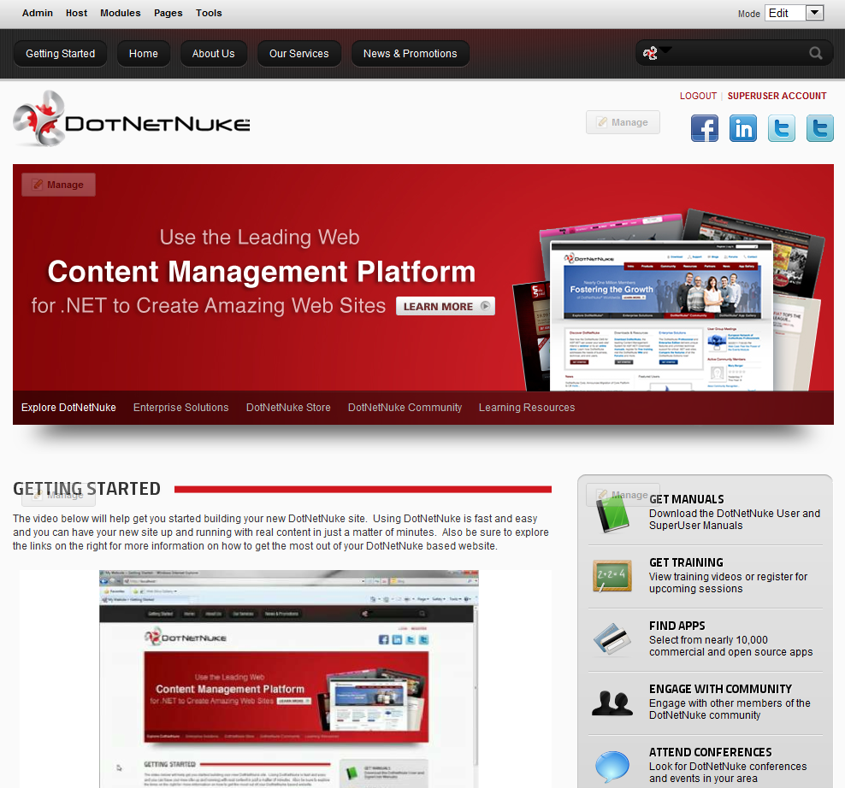
[Case Study]

Slide 12
Goals
Updated, modern, user interface
Consistent user experience
Ease of implementation
Reuse by third party developers

Slide 13
[Demo]

Slide 14
Demo Review
Collection of plugins (UI widgets)
Use smart defaults
Based on established HTML Conventions
Public API used for configuration as needed
Generally very simple to consume

Slide 15
[Creation]

Slide 16
Creating a Plugin
Wrap business logic with plugin logic
Logic can stay largely the same
Modify to inject settings and context
Modify for safety and to play well with others

Slide 17
First things first
Always wrap in a closure
(function($){
// ahhh…safety
})(jQuery);

Slide 18
Define Your Plugin
No selecting needed
  $.myPlugin = function(options){…};
Select and return (chain)
  $.fn.myPlugin = function(options){
    return this.each(function(){
    …
    });
  };

Slide 19
Establish Default Options
$.fn.myPlugin.defaultOptions = {
speed: ‘slow’
};
var opts = $.extend({}, $.fn.myPlugin.defaultOptions, options),

Slide 20
Inject HTML Context
Options aren’t just for “settings”
Inject all context through options
$(‘.nav’).myPlugin({
speed: ‘fast’
subNavSelector: ‘li.subnav’,
});

Slide 21
Events
Sure you need to enforce doc ready?
If you’re ever unbinding events, bind them with a namespace first.
Favor this:
$(‘elem’).unbind(‘click.Namespace’, function(){…});
Instead of this:
$(‘elem’).unbind(‘click’, function(){…});

Slide 22
[Code Demo]

Slide 23
Ian Robinson
Twitter @irobinson
GitHub http://github.com/irobinson
Professional Profile http://bit.ly/irobinson
jQuery Crash Course
  http://jquery.ian-robinson.com

Slide 24
References
http://nathansjslessons.appspot.com
http://api.jquery.com
http://benalman.com
http://msdn.microsoft.com/en-us/scriptjunkie
http://marcgrabanski.com/articles/jquery-plugins-toolbox
http://www.dotnetnuke.com/Resources/Wiki/Page/Reusable-DotNetNuke-jQuery-Plugins.aspx

